Slide 1
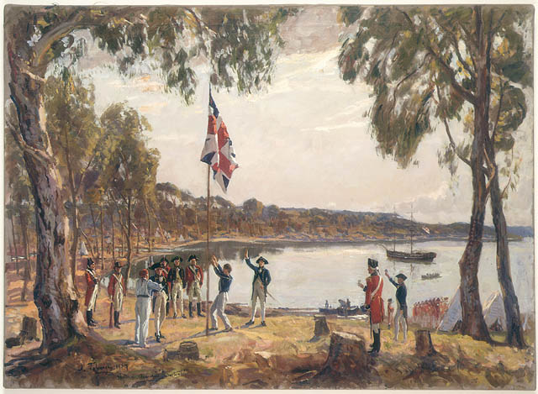
Australian Colonies

Slide 2
Quick Quiz!
In what year did Britain set up its first permanent colony?
How many ships were in the First Fleet?
What was Australia originally called by the people of the First Fleet?
What year did the British Government stop sending convicts to New South Wales?
Name three occupations in an early Australian colony?
Is there anything else you remember from our lessons on early Australian Colonies?

Slide 3
Diaries
What are diaries?
What are they used for?
What do people normally put in them?
Some kinds of diaries may include;
Personal daily diary or journal, commenting on the days events, how the person feels and maybe offering comments about what is going on around them (what they believe or think.)
Travel diary, commenting on where the person has been, what they have seen, what they loved etc.
War diary, often used as an outlet for soldiers to ‘let out’ what is going on inside them and around them.
There are many others!
But we are going to be focusing on a private daily diary

Slide 4
Video Diaries
What are video diaries?
How do they differ from normal diaries?
They have come about from the advances in technology so rather than spending a long time writing something down, videoing an entry takes a lot less time.
Some examples of video diaries can be found in movies such as ‘Avatar’ where the character Jake Sully documents his days as part of the Avatar tribe.
Or in the movie ‘Tomorrow When The War Began’ where the character Ellie is documenting what is happening and how they (as a group) feel about the war that is taking place in their hometown, Ellie also ponders about WHY things are happening and what they mean.
Can you think of any other examples? What about the TV show ‘The Block’?
*NOTE ‘Avatar’ at 57:40, and 1:15:04 will show examples of these video diaries, as well as the opening and closing scenes of ‘Tomorrow When The War Began’

Slide 5
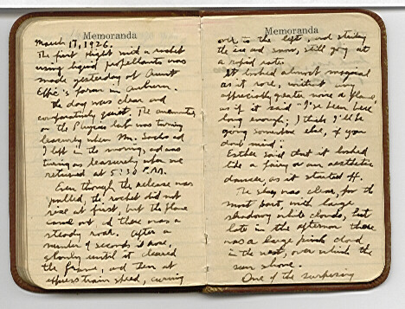
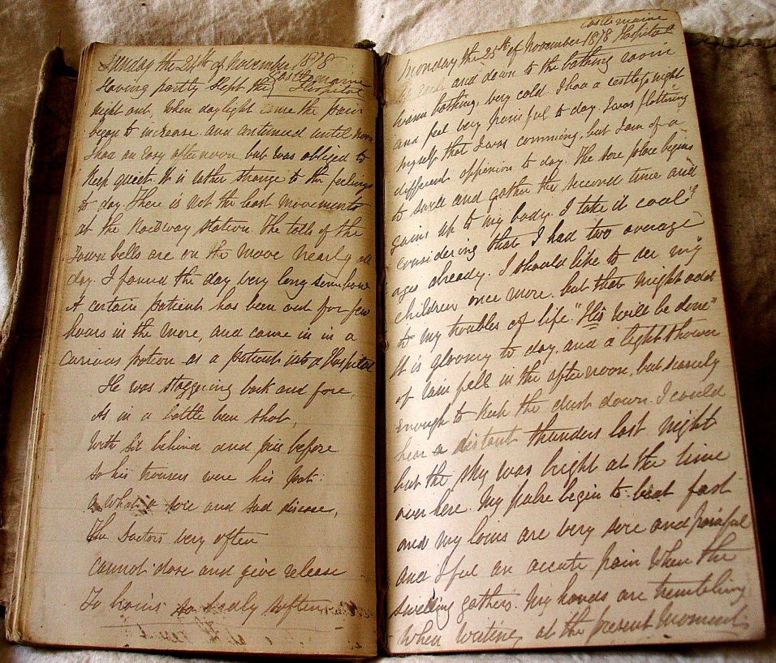
What do you include in your entry?
- Short introduction
- Comment on any events of the day
- How you felt about those events
- Offering your opinion on anything that is going on around you

Slide 6
Video Diary Project
TASKS
Choose a person/character from early Australian colonial times (eg. Farmer, miner, young girl/boy who is a British migrant)
Come up with a number of questions (minimum three) to form a historical enquiry into your character and research what their life might be like (daily life, relationships, significant events)
Create a character profile, including a picture about your person and specific information about them (age, location, family, likes/dislikes and anything else you can come up with!)
Plan and write four diary entries for your character using the ‘Diary Entry Guideline’ page. Make sure you edit your work!
Plan your video diary by outlining the clothes you will wear and where you will ‘set’ your video (what will be in the background??)
Practise and then film your video diary entries using the class iPads, putting them together using iMovie.
Write a 30 second introduction of your character, that you will present in front of the class with your video diaries.
* Hand out Video Diary Project Booklets

Slide 7
Simplified!
Choose a character
Come up with three questions to guide your research
Create a character profile
Plan and write four diary entries for your character
Plan your video diary (costume and set)
Practise and then film your video diary entries
Write a 30 second introduction of your character

Slide 8
Today…
Choose your person/character
Create their character profile using your creative thinking
Come up with three questions to guide your research about their daily life, relationships, significant events etc.
Any questions???

